Slide 1
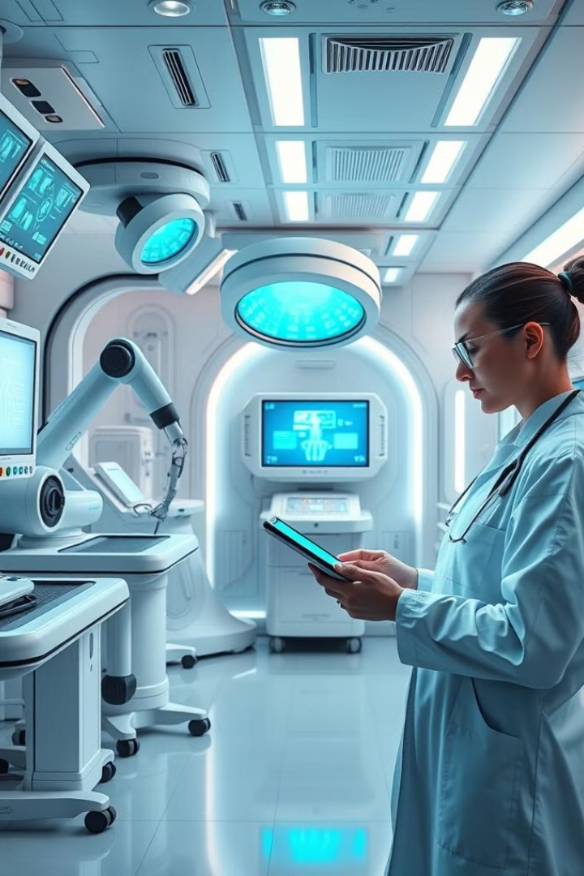
Multiple Disease Detector using Machine Learning
This presentation explores the potential of machine learning to revolutionize medical diagnosis, improving accuracy, efficiency, and patient outcomes.

Slide 2

CONTENTS
INTRODUCTION
OBJECTIVES
PROBLEM STATEMENT
PROPOSED SOLUTION
DIABETES PREDICTION
HEART DISEASE PREDICTION
PARKINSONS PREDICTION
MALARIA PREDICTION
CHICKEN POX PREDICTION
TUBERCULOSIS PREDICTION
FUTURE SCOPE
CONCLUSION

Slide 3
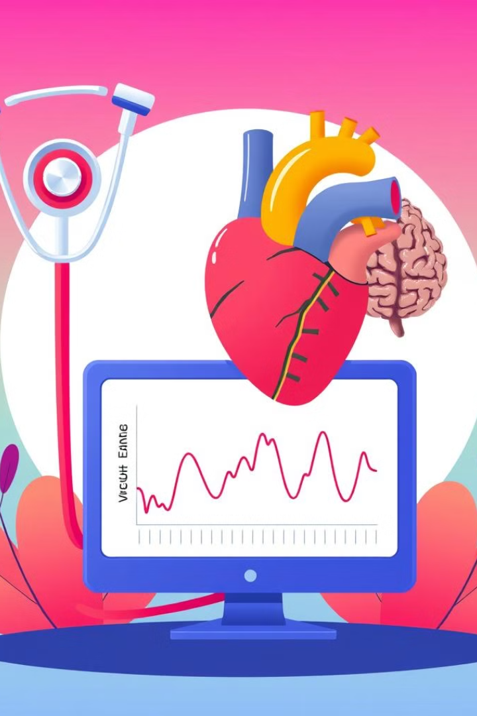

Introduction
Machine Learning
Medical Diagnosis
Machine learning algorithms analyze large datasets to identify patterns and make predictions.
This technology can be applied to medical data to predict disease, diagnose conditions, and personalize treatment plans.

Slide 4
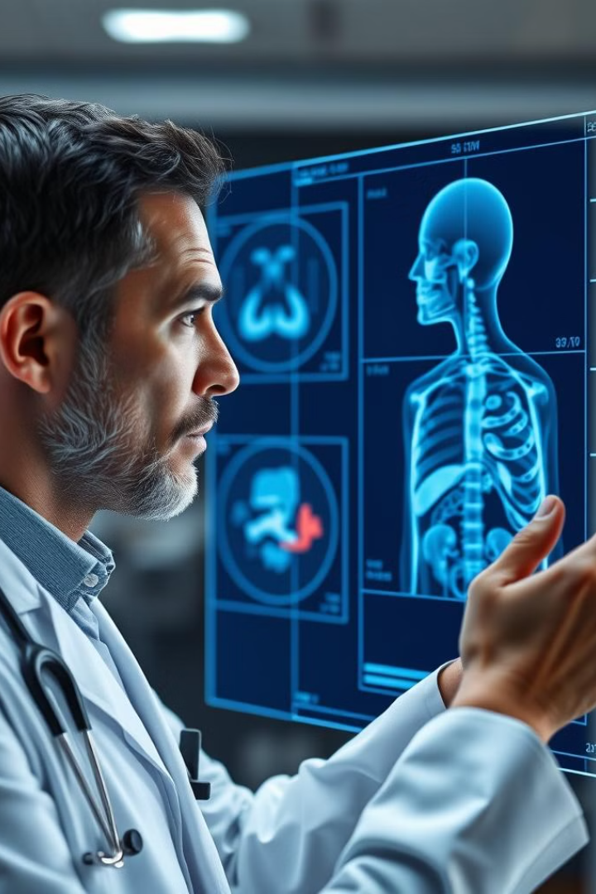
Objective
Predict Disease
Imagine empowering doctors with the ability to predict diseases before they even manifest, potentially saving lives.
Improve Accuracy
Imagine a future where medical diagnosis is more accurate than ever before, leaving no room for doubt.
Early Detection
Imagine catching diseases early, when they are most treatable, giving patients the best chance at a healthy future.

Slide 5
PROBLEM STATEMENT
Healthcare systems globally are under immense pressure to deliver timely, accurate diagnoses for various diseases. Conventional diagnostic approaches often involve physical tests, laboratory work, and specialized medical expertise, which may not be readily available to everyone, especially in under resourced areas. Early detection is vital for diseases like diabetes, heart disease, Parkinson’s, malaria, and chickenpox, as it can significantly reduce morbidity and mortality rates. However, delays in diagnosis due to accessibility issues or prolonged testing processes can result in disease progression, increased healthcare costs, and poorer patient outcomes. The challenge is to develop a system that can efficiently predict the likelihood of these diseases using available patient data and common health indicators. Such a tool would benefit healthcare providers by supplementing their diagnostic efforts and offering preliminary screening for at-risk individuals, thus allowing for faster intervention and better management of healthcare resources.

Slide 6
PROPOSED SOLUTION
This project proposes a machine learning-based solution that can predict multiple diseases—diabetes, heart disease, Parkinson’s disease, malaria, and chickenpox—based on relevant health parameters. By analyzing patterns in health data, machine learning algorithms can assist in identifying early signs of these diseases. The proposed system will provide a single, user-friendly interface where users can input health-related data, such as blood pressure, cholesterol levels, vocal features, or symptoms like fever and rash. The application leverages supervised learning techniques, trained on publicly available datasets for each disease. Different algorithms are evaluated to find the most accurate model for each disease category. The final system incorporates these models, allowing healthcare professionals and patients to input data and receive immediate predictions regarding the risk level for each disease. The goal is to develop a quick, accessible, and accurate tool for multi-disease prediction, with potential integration into telemedicine platforms.

Slide 7
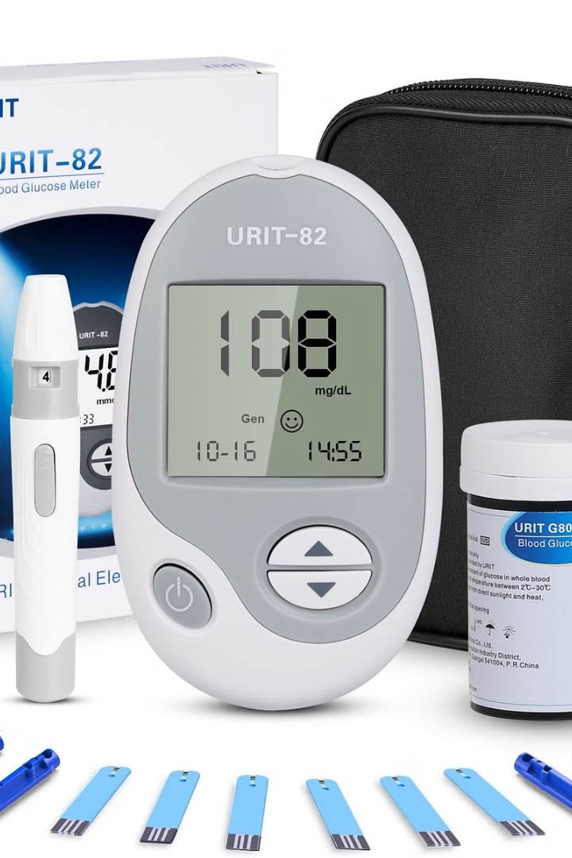



Diabetes Prediction
Blood Sugar
The model analyzes blood sugar levels, insulin resistance, and other related factors.
Body Mass Index
BMI and other weight-related indicators are crucial for assessing diabetes risk.
Family History
Genetic predisposition plays a significant role in diabetes development.

Slide 8




Heart Disease Prediction
Risk Factors
1
Age, smoking, cholesterol, and family history are major risk factors.
Cardiac Data
2
The model analyzes electrocardiograms, blood pressure, and heart rate.
Prediction
3
The model predicts the likelihood of heart disease development.

Slide 9
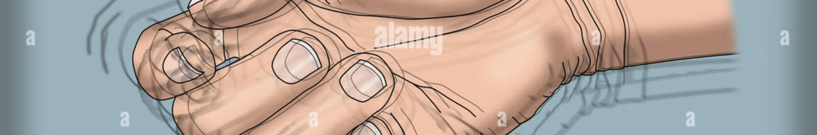
Parkinsons Disease Prediction
Early Symptoms
Tremors, slow movements, and stiffness are common initial symptoms.
Prediction
The model predicts the likelihood of Parkinson's disease.
1
2
3
Voice Analysis
The model analyzes voice recordings for changes in pitch, tone, and volume.

Slide 10
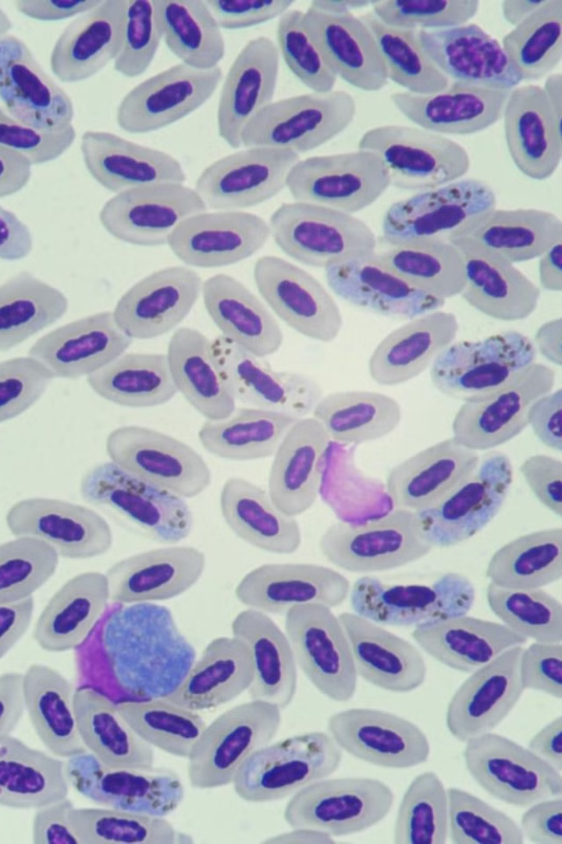



Malaria Prediction
Blood Samples
The model analyzes blood samples for the presence of malaria parasites.
Microscopic Analysis
The model analyzes the size, shape, and characteristics of the parasites.
Prediction
The model predicts the likelihood of malaria infection.

Slide 11
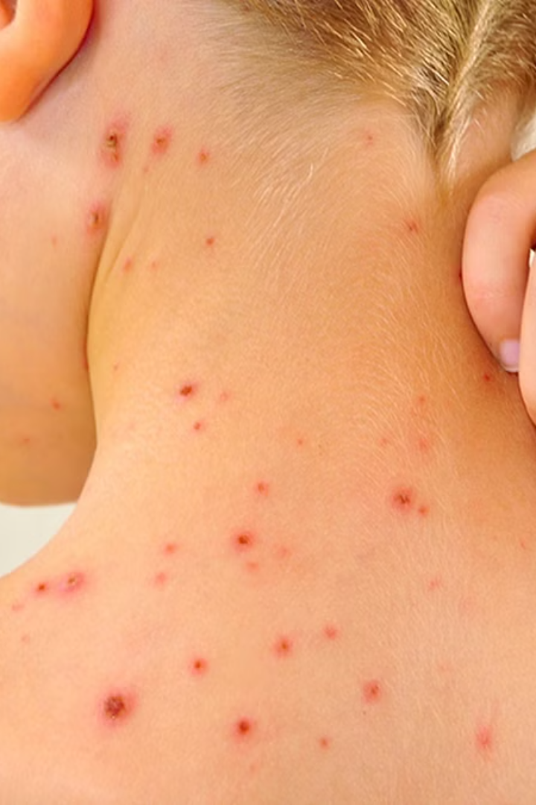
Chicken Pox Prediction
1
Rash
The model identifies characteristic red spots and blisters.
2
Fever
Elevated body temperature is a common symptom.
3
Fatigue
Exhaustion and weakness are often associated with chicken pox.

Slide 12
Tuberculosis Prediction
Cough
1
Persistent coughing, often with blood, is a common symptom.
Fever
2
Elevated body temperature is a common symptom.
Prediction
3
The model predicts the likelihood of tuberculosis infection.

Slide 13
FUTURE SCOPE
This multi-disease prediction model has substantial potential for future development and enhancements. Some areas for future improvement include:
Incorporation of More Diseases: Expanding the model to cover additional diseases can increase its utility and make it a more comprehensive diagnostic tool.
Integration with Electronic Health Records (EHR): By integrating with EHR systems, the model could access a wider range of patient health data, leading to more personalized and accurate predictions. ‘
Use of Deep Learning Techniques: For diseases that have complex patterns within datasets, deep learning methods, such as Convolutional Neural Networks (CNNs) for image-based data (e.g., malaria diagnosis), could enhance accuracy.
Real-Time Monitoring: Integration with wearable devices could enable real-time data collection, allowing the system to monitor health parameters continuously and provide instant alerts in case of high-risk readings.
Explainability and Interpretability: Including model interpretability features would help healthcare professionals understand the model’s decision-making process, increasing trust and usability in clinical settings.
Multi-Language Support: Adding multi-language capabilities would increase accessibility for non-English speaking users, making the tool beneficial on a global scale.

Slide 14

Conclusion
Machine learning has the potential to transform medical diagnosis, leading to more accurate and timely diagnoses, improved patient outcomes, and a more efficient healthcare system.

